Slide 1


Sync outside the box
Nextcloud guiding principles
Jan-Christoph Borchardt @jancborchardt

Slide 2

Quick backstory …

Slide 3



May & June 2016
forked

Slide 4
nextcloud.com
/migration

Slide 5
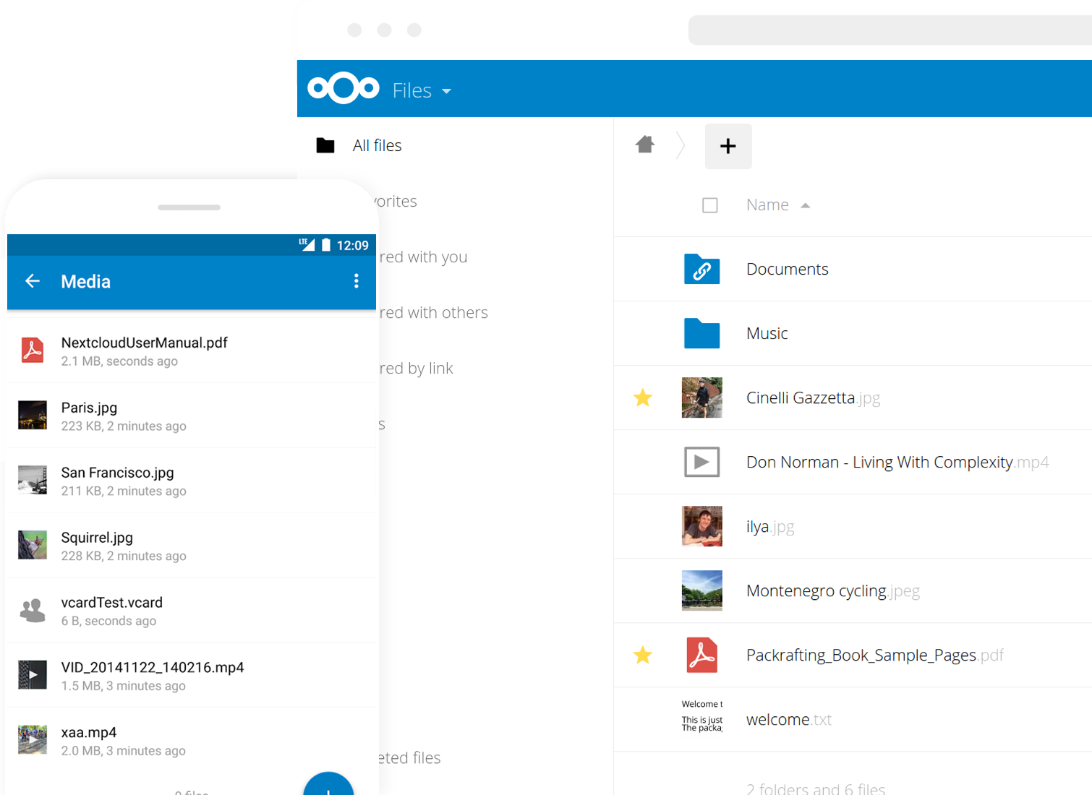
Nextcloud

Slide 6
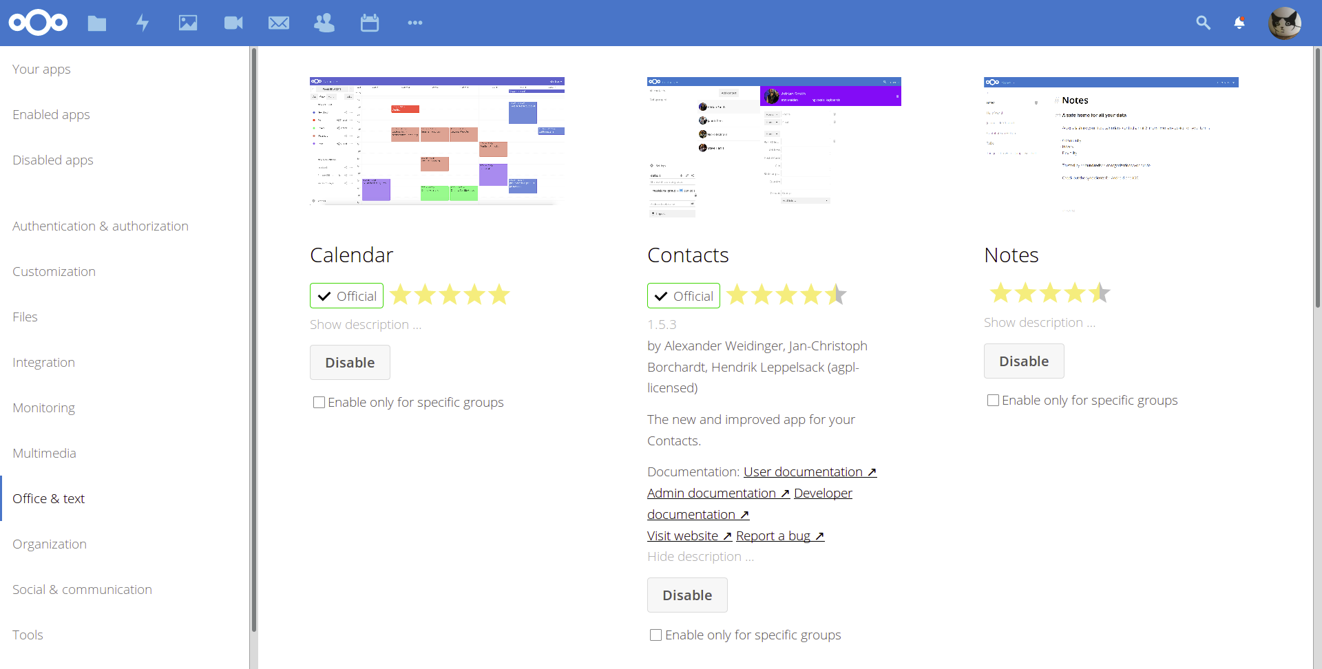

Slide 7
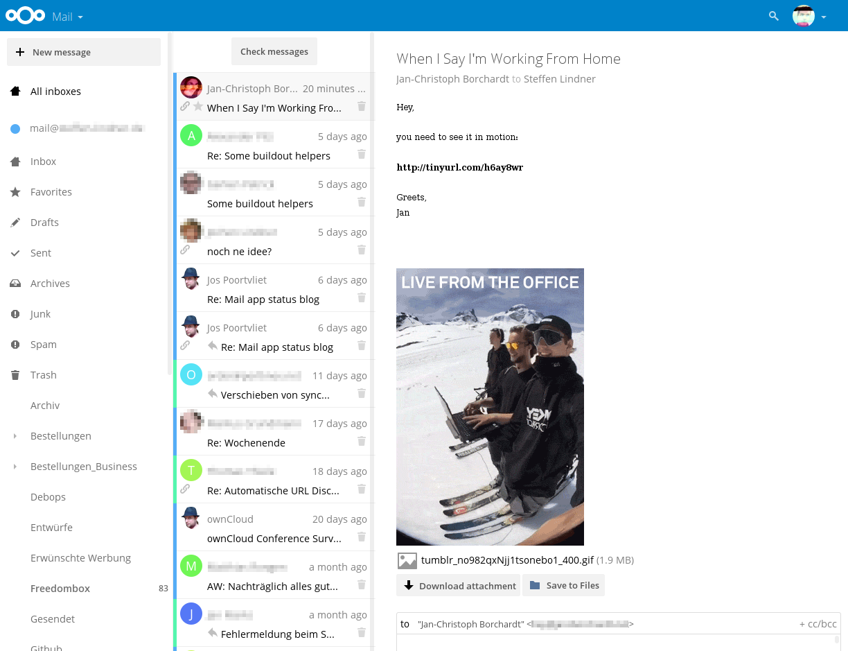

Slide 8
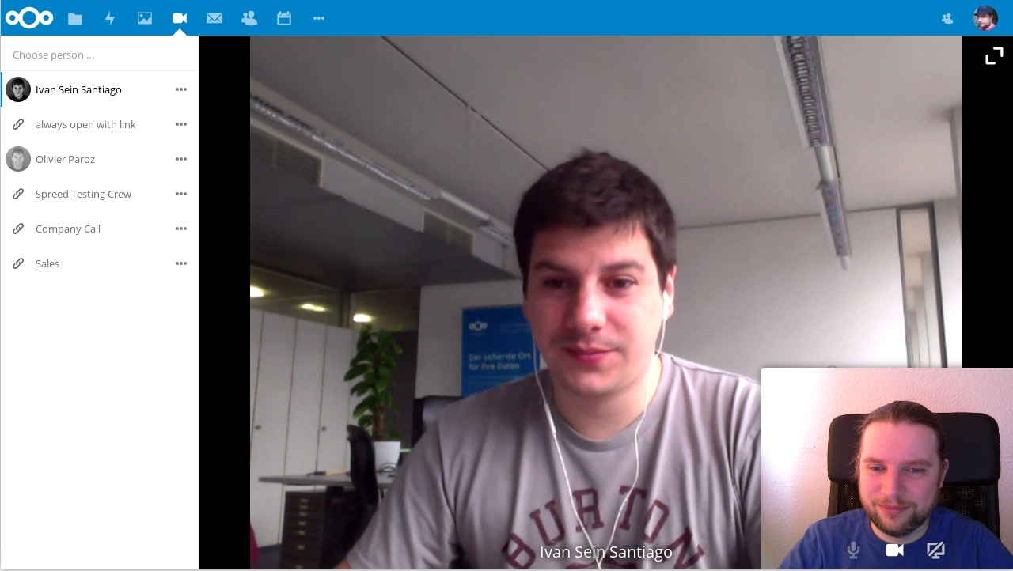

Slide 9
Project & community
– not just a product

Slide 10
6
Guiding principles
& values

Slide 11
1
Financial sustainability

Slide 12
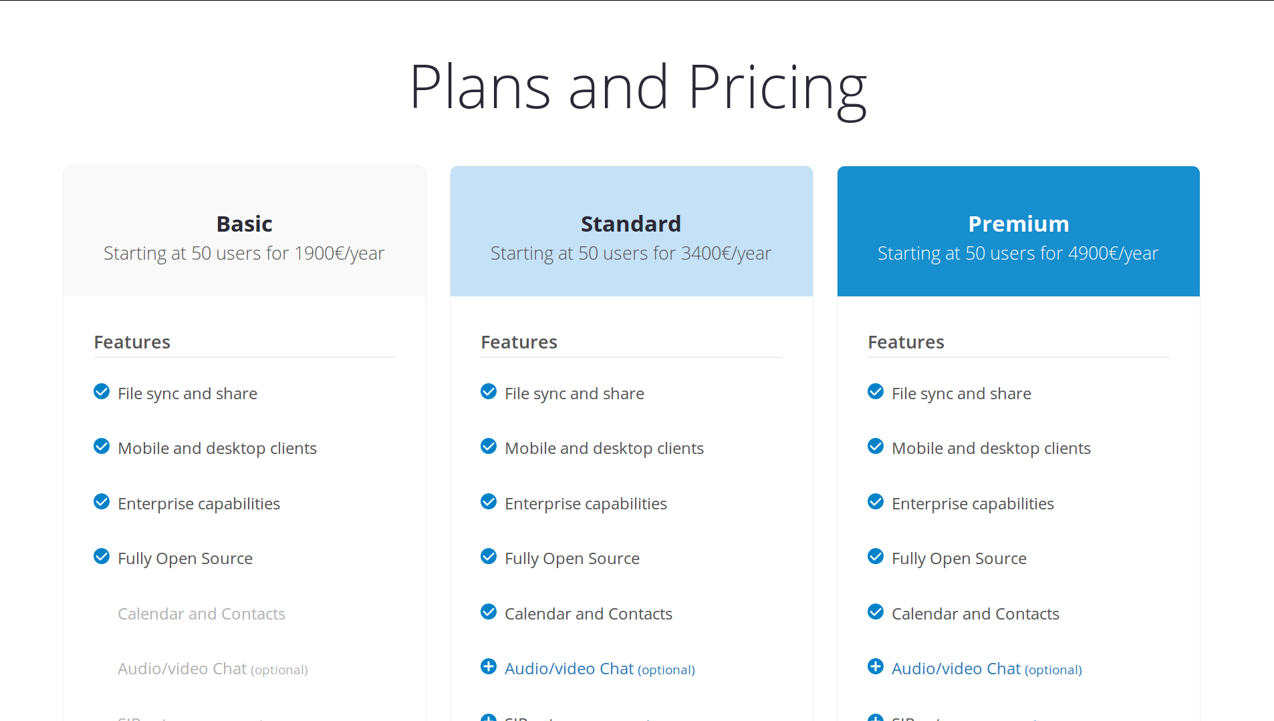
No closed source parts No venture capital

Slide 13
2
Free & open source software

Slide 14
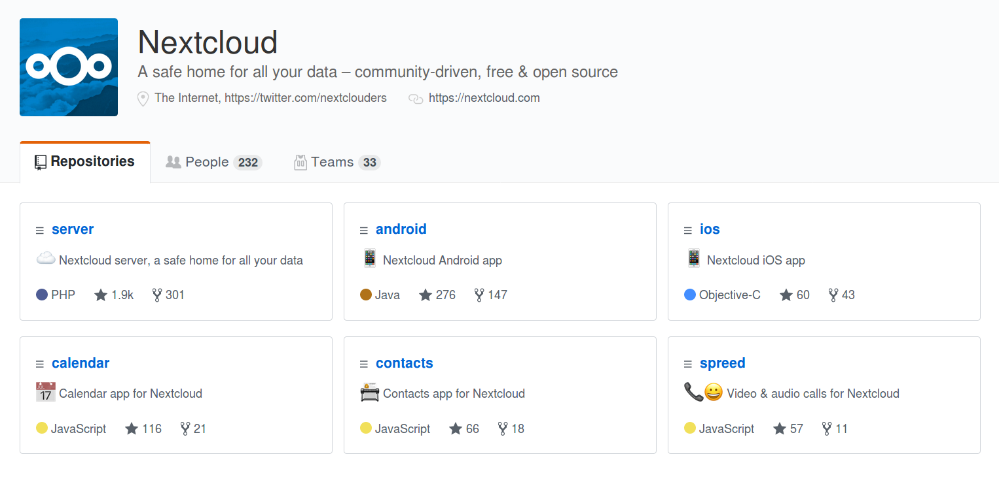
All AGPL No Contributor License Agreement

Slide 15
3
Open standards

Slide 16




WebDAV CalDAV CardDAV
WebRTC XMPP RSS IMAP

Slide 17
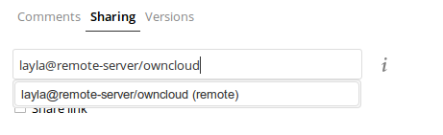


Federation

Slide 18
4
Collaboration with other projects

Slide 19
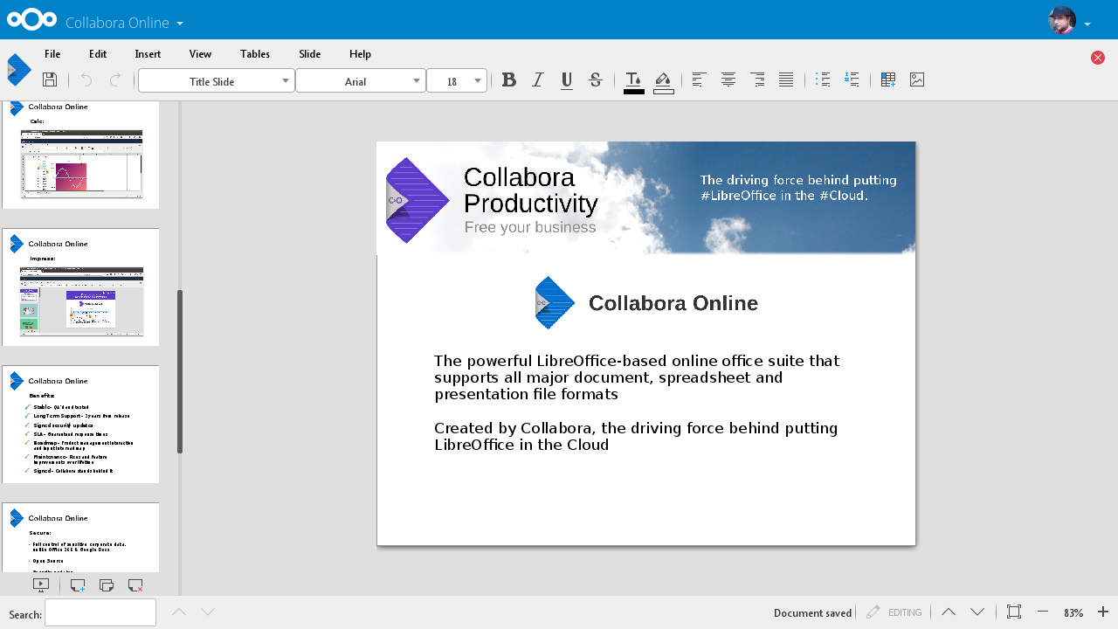

Slide 20
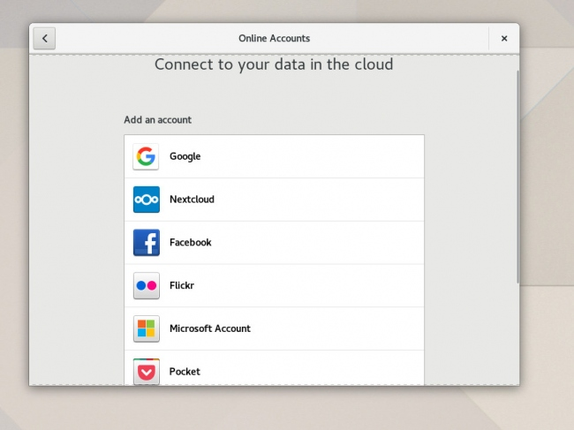

Slide 21
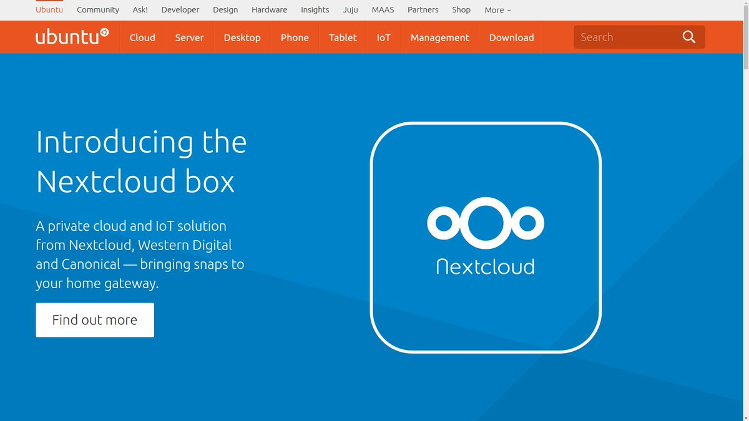

Slide 22
5
Community online & offline

Slide 23
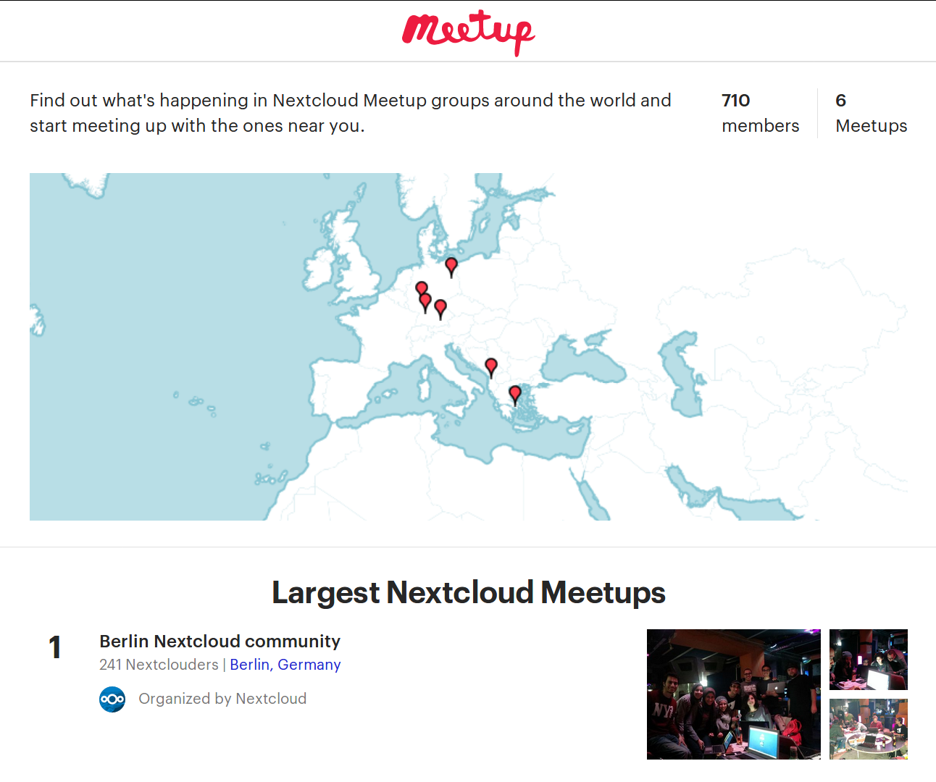

Slide 24
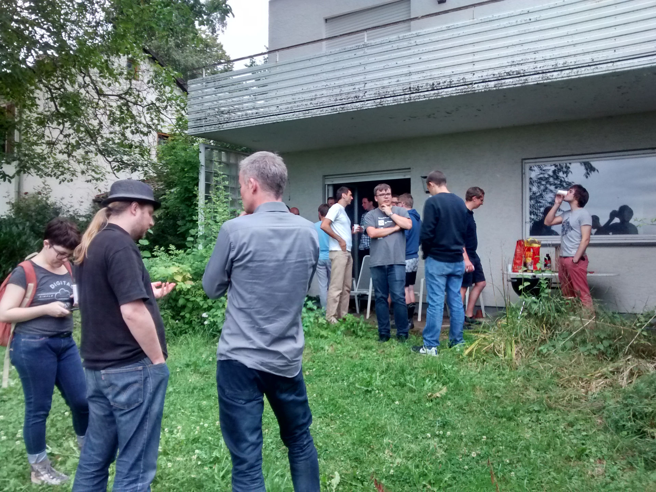

Slide 25
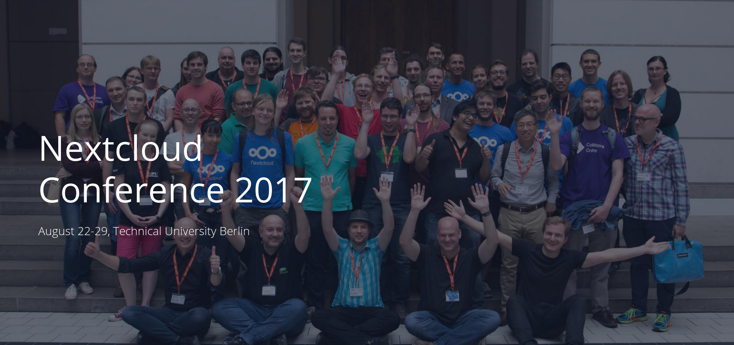

Slide 26
6
Diversity
& inclusion

Slide 27




Slide 28
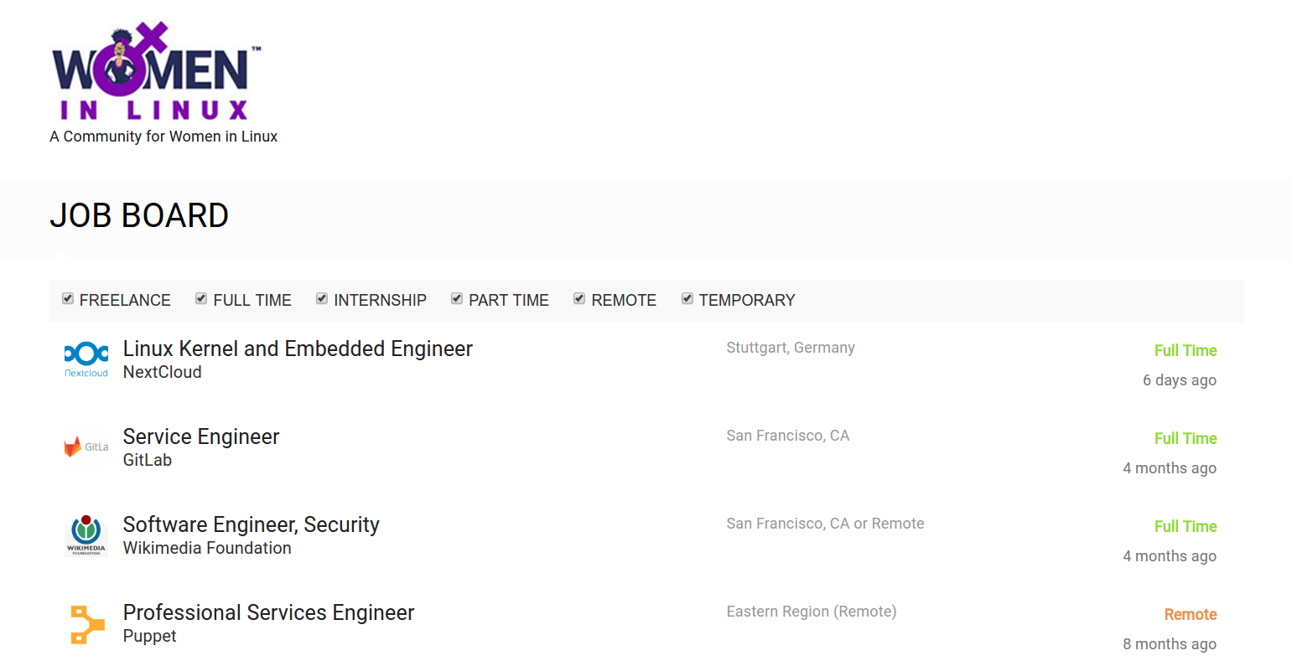

Slide 29
starter issue
yourfirstpr.github.io up-for-grabs.net

Slide 30
nextcloud.com
/contribute
Thank you ❤️️
Jan-Christoph Borchardt @jancborchardt

